Slide 2
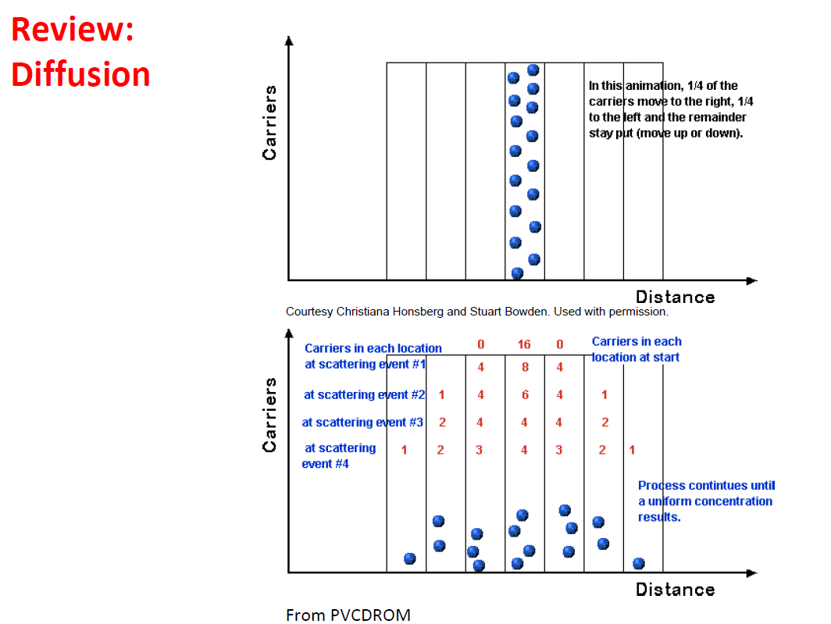

Slide 5
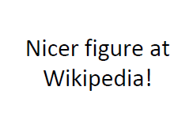
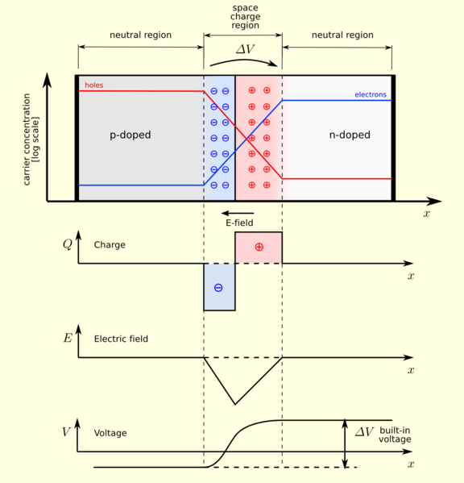

Slide 6
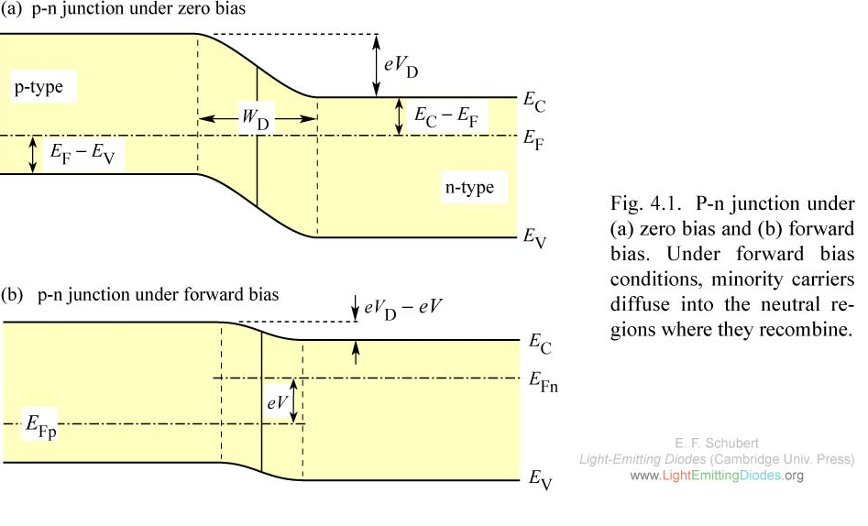

Slide 7
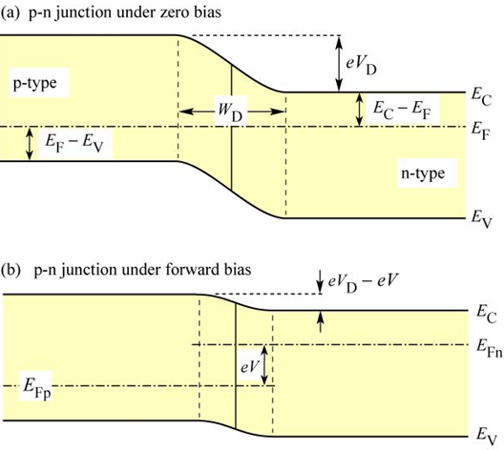
Eg
E2
E1
Substituting
No external voltage applied (No bias)

Slide 8
VA - External applied voltage

Slide 9
Law of mass action

Slide 10
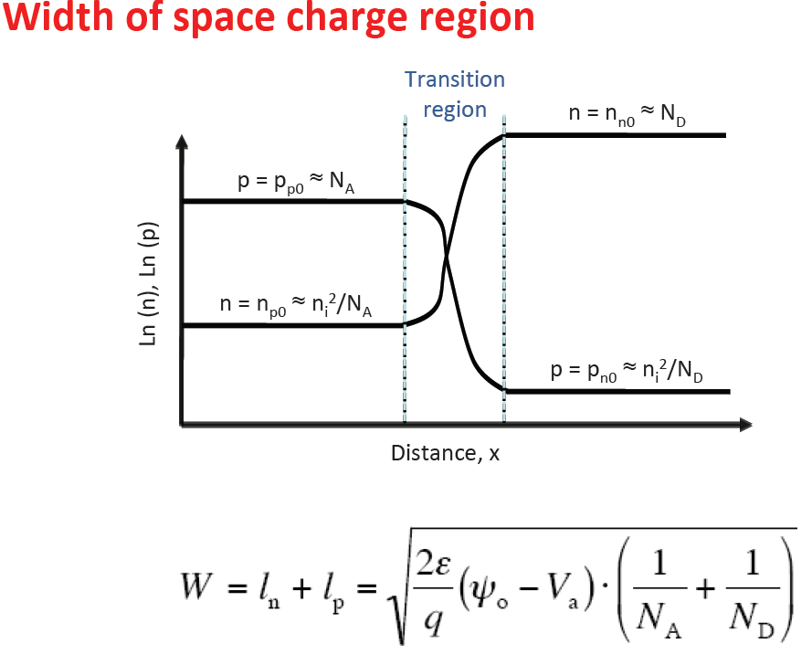
Lp
Ln

Slide 12
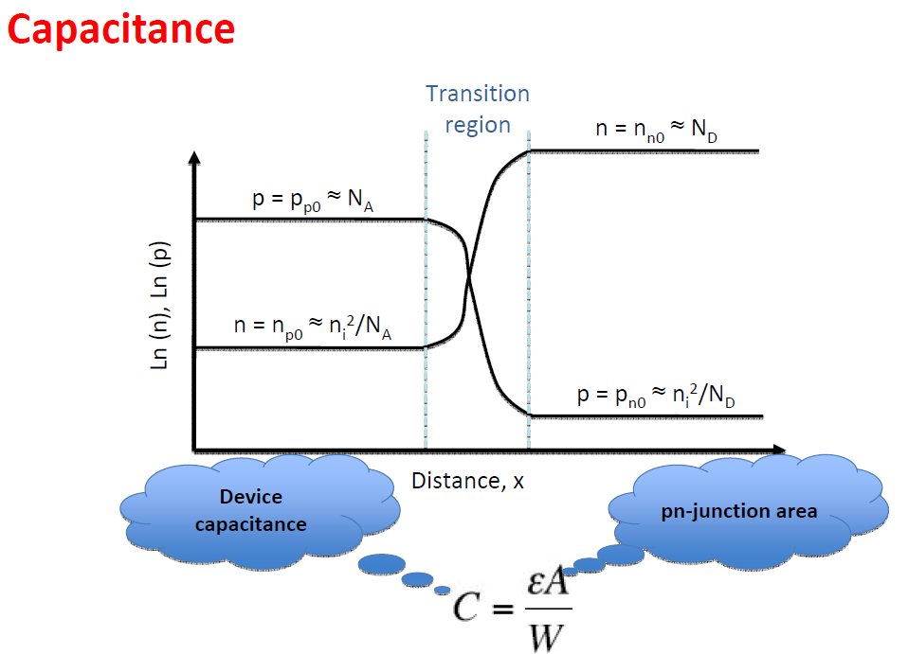
A – Area of the capacitance

Slide 14
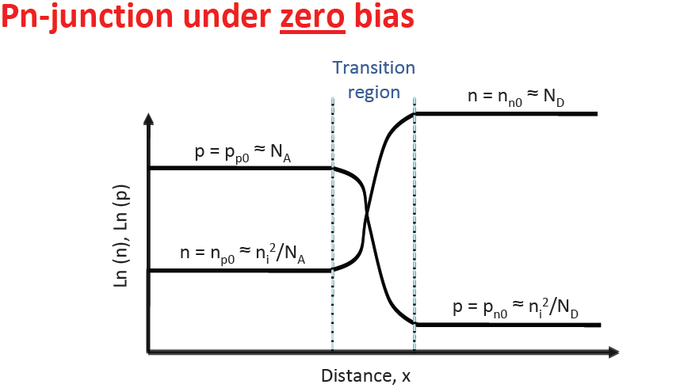

Slide 15
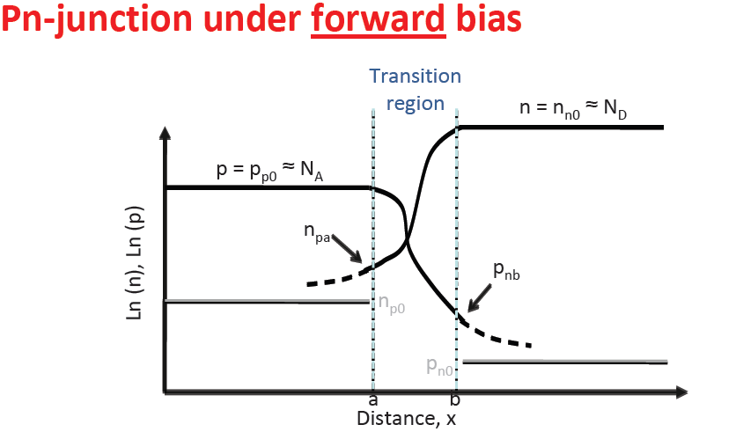

Slide 17
.q – elementary charge
µ - mobilitty
P – carrier conentration
E – electric field
Dh – Diffusion constant
Change in carrier concentration over real space

